Slide 1
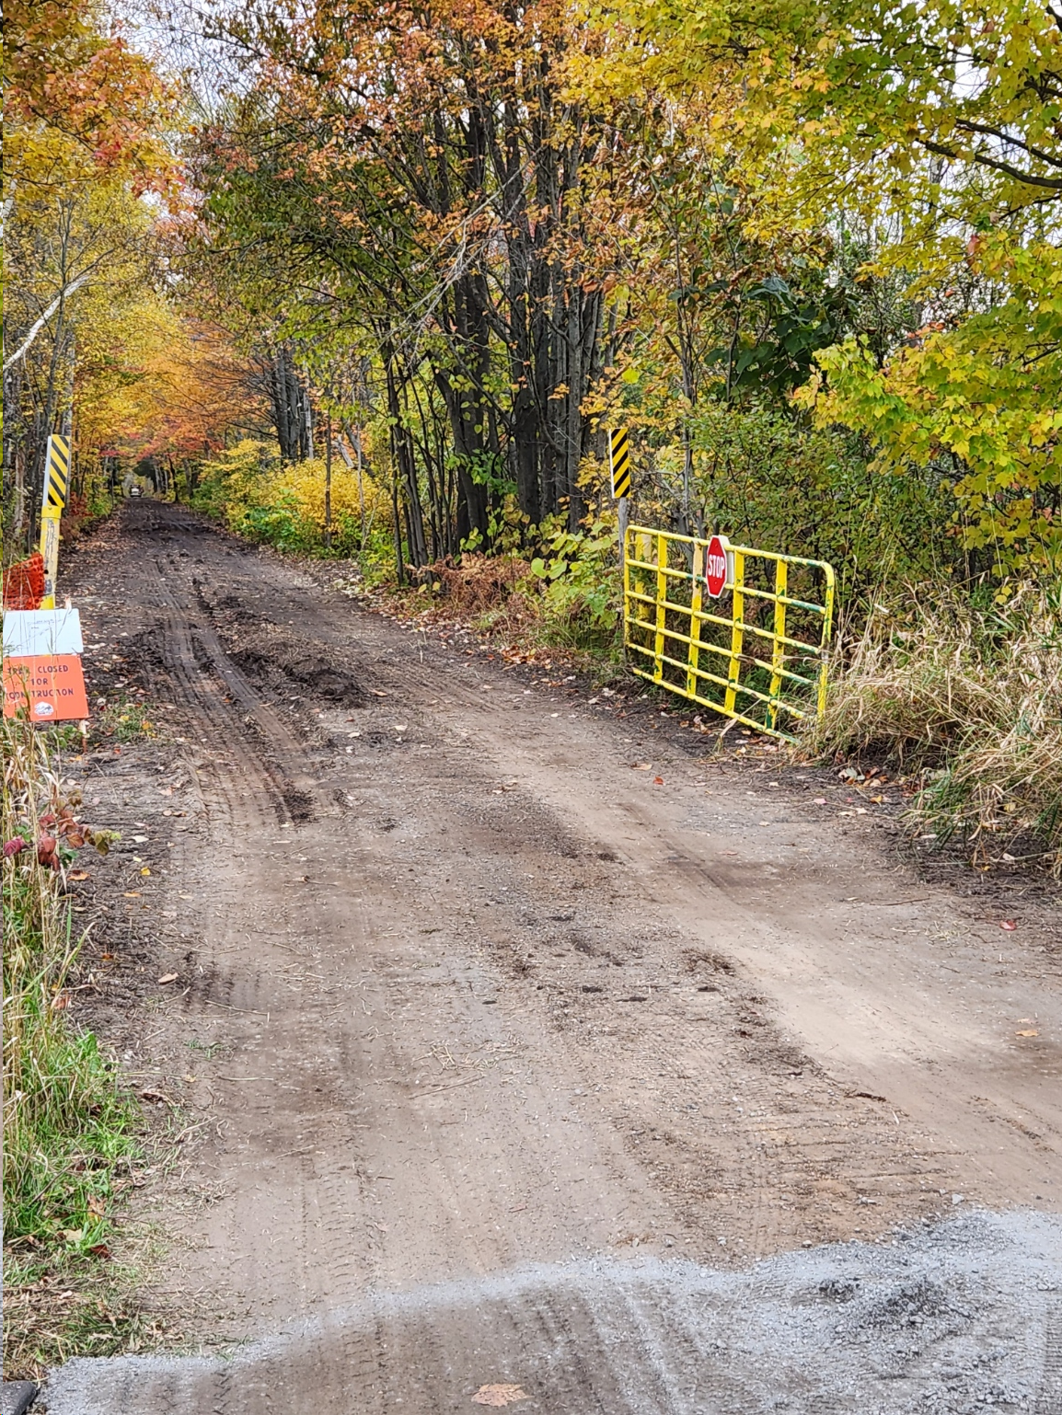
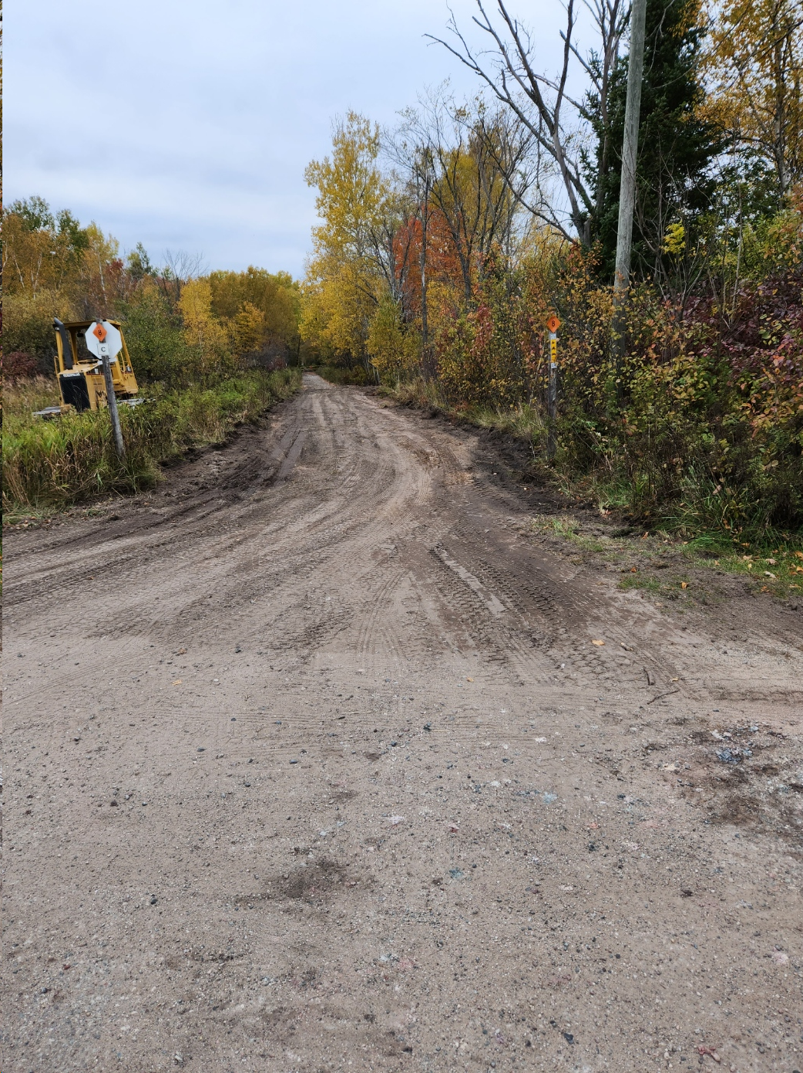
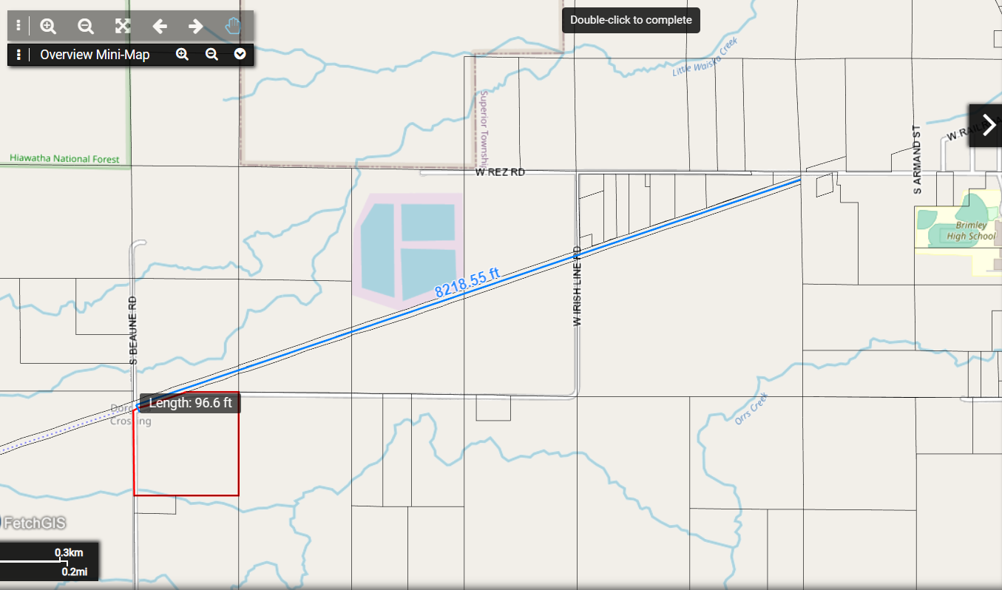
Chippewa County SORVA 2024 Grant Funds ORV Trail Improvement West of Brimley - Completed
West of Brimley from the gate west of Beaune Rd 450 ft east to Beaune Rd and continuing 8220 ft to Irish Line Rd 450+ 8220 = 8700 ft
Soft and watery sections of Trail at the beginning of construction

Slide 2
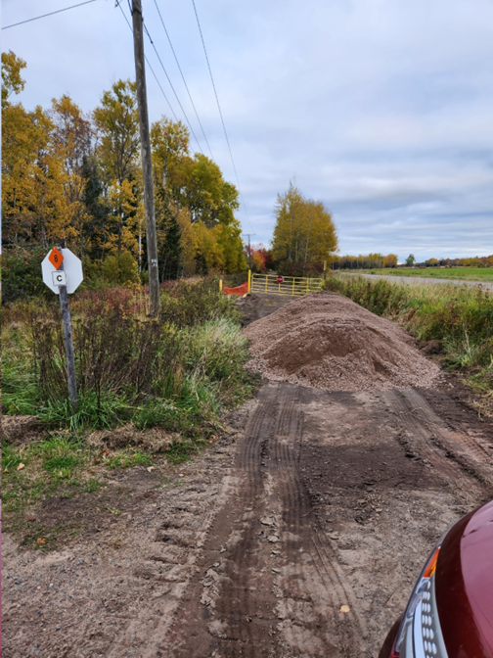
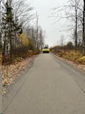
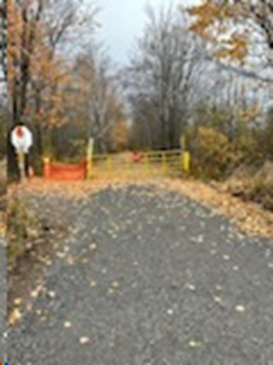
Chippewa County SORVA 2024 Grant Funds ORV Trail Improvement West of Brimley - Completed
Backfilling low spots with gravel before slag stone addition
Vibratory compaction after addition of topping slag
Finished Section of trail

Slide 3
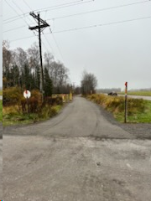
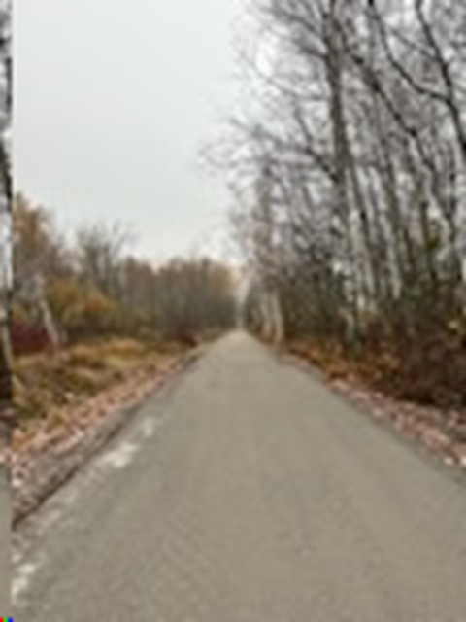
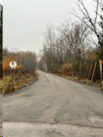
Chippewa County SORVA 2024 Grant Funds ORV Trail Improvement West of Brimley - Completed
Various completed sections of the trail

